Slide 1
Practical Java
Kristof Werling
April 2022

Slide 2
Organizational Info

Slide 3
Each day of the lecture
2 Parts
Part 1:
Learn about new Java concepts and functionality
Easy and short exercises to enhance the understanding of the material
Part 2:
Use the new concepts and functionality of Part 1 to enhance and extend the Converter project

Slide 4
Part 1 – more details
There will be exercises
Each execise comes with a solution
Each exercise will be discussed with the whole group and problems / issues will be addressed
The solution provided also will be discussed

Slide 5
Depth of the information provided
For the most part the information provided is sufficient to work out the solution to the execises
For most of the concepts and functionality shown there is a vast body of knowledge we cannot explore in any kind of practical manner.

Slide 6
Project for this lecture
Project
Converter: Markdown to Latex and later to Html
Simple solution.
Each lecture works on one aspect of the solution (like: GUI, DB, …)

Slide 7
Markdown Tags
Project
Headings | Text Formatting | Rendered Output
# Heading level 1 | **This is bold text** | Link to [Google](https://www.google.com/)
## Heading level 2 | __This is bold text__ | - Unordered List Item 1 - Unordered List Item 2 - Unordered List Item 3
### Heading level 3 | *This text is italicized*
#### Heading level 4 | ~~Strikethrough text~~
##### Heading level 5 | ***Bold and italics text*** | 1. Ordered List Item 1 1. Ordered List Item 2
###### Heading level 6 | **Bold and *nesting italics* text**
Source: https://www.markdownguide.org/basic-syntax
Or
https://docs.github.com/en/get-started/writing-on-github/getting-started-with-writing-and-formatting-on-github/basic-writing-and-formatting-syntax All the gory details (specs): https://github.github.com/gfm/

Slide 8
Latex
Project
Boiler Plate for a Latex Document | \documentclass[12pt, a4paper] {article} \begin{document} Here goes the document. \end{document}
Source: https://www.overleaf.com/learn/latex/Learn_LaTeX_in_30_minutes

Slide 9
Latex
Project
Bold | This is \textbf{bold text}
Italic | This is \textit{text in italic}
Strikethrough
Unordered List | \begin{itemize} \item Item 1 \item ... \end{itemize}
Ordered List | \begin{enumerate} \item Item 1 \item ... \end{enumerate}
Link | Use the hyperref package
Source: https://www.overleaf.com/learn/latex/Learn_LaTeX_in_30_minutes

Slide 10
Latex
Project
Heading 1 | \section{section}
Heading 2 | \subsection{subsection}
Heading 3 | \subsubsection{subsubsection}
Heading 4 | \paragraph{paragraph}
Heading 5 | \subparagraph{subparagraph}
Source: https://www.overleaf.com/learn/latex/Learn_LaTeX_in_30_minutes

Slide 11
What we need to get started
Preparation
IntelliJ Community Edition (Download here)
MiKTex (or any other Tex that can process Latex) (Download here)
OpenJDK Java 18 (Download here)
Markdown Viewer (For example: Windows Markdown Viewer)
Git for Windows (Download here)

Slide 12

Github.Com Account
Preparation
Sign in or Sign up

Slide 13
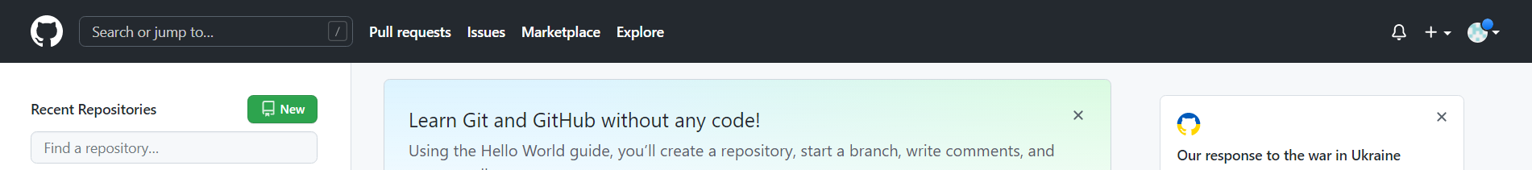
Create new Repository
Preparation
New Repository

Slide 14
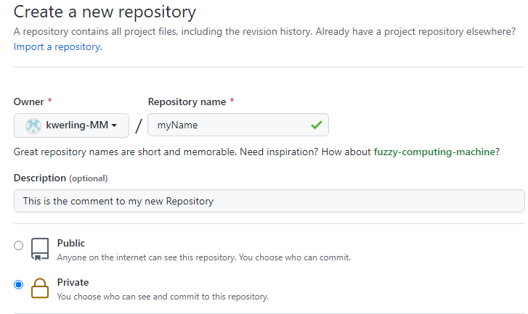
Create new Repository 1 of 2
Preparation
Repository name
Comment, if wished
Private or Public access

Slide 15
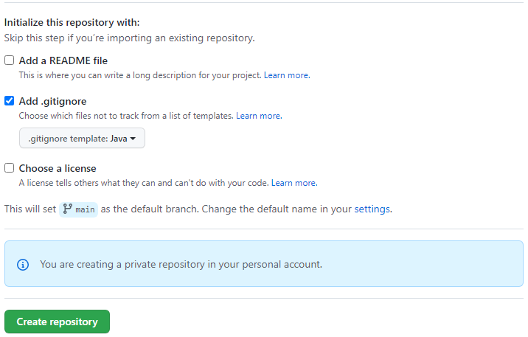
Create new Repository 2 of 2
Preparation
Add .gitignore for JAVA
Create it

Slide 16
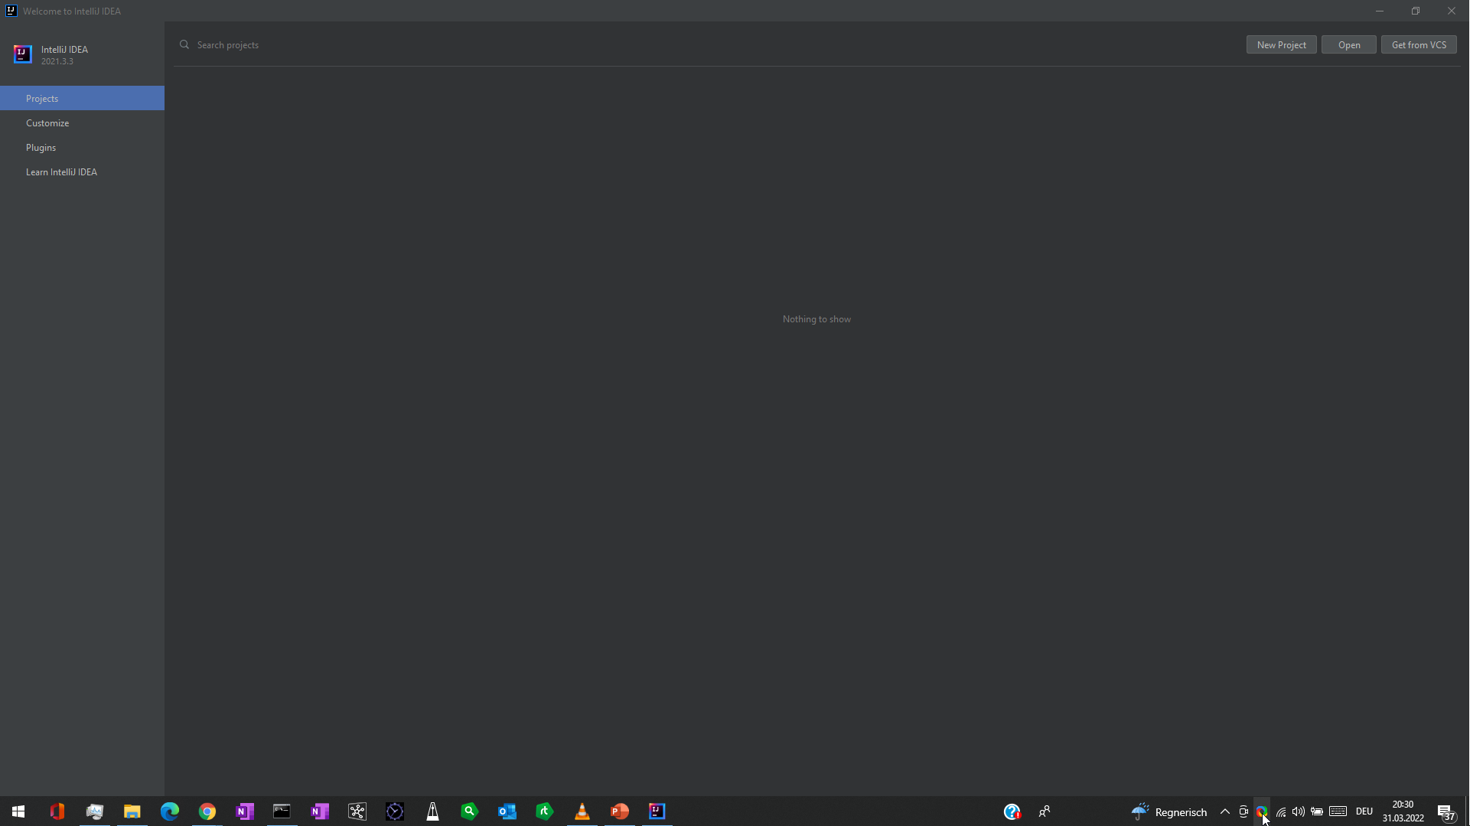
Creating a new project 1 of 5
Preparation
New Project

Slide 17
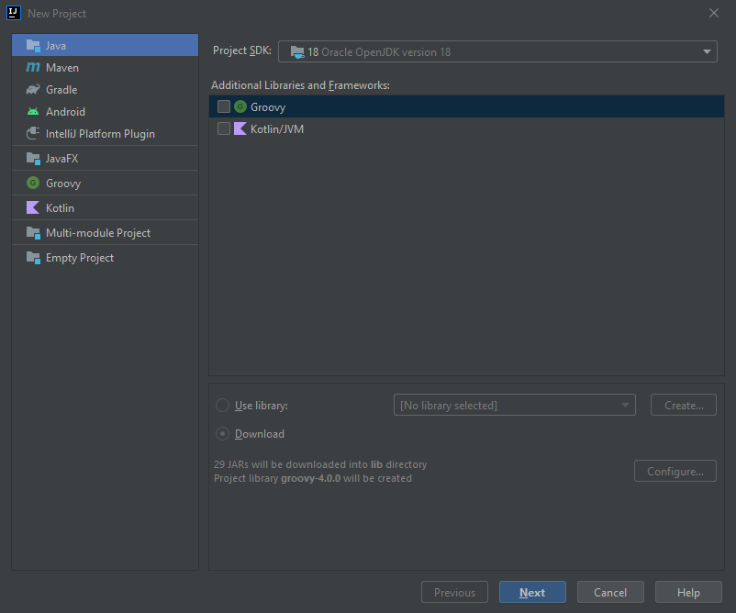
Creating a new project 2 of 5
Preparation
Make sure your JDK is listed here
Java
Press Next

Slide 18
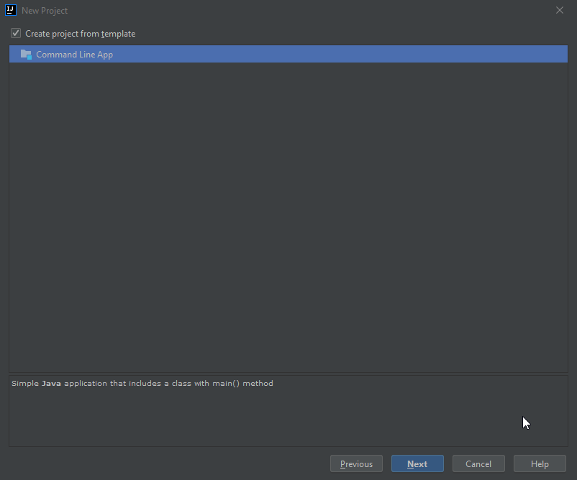
Creating a new project 3 of 5
Preparation
Choose the Commend Line Template to get started
Press Next

Slide 19
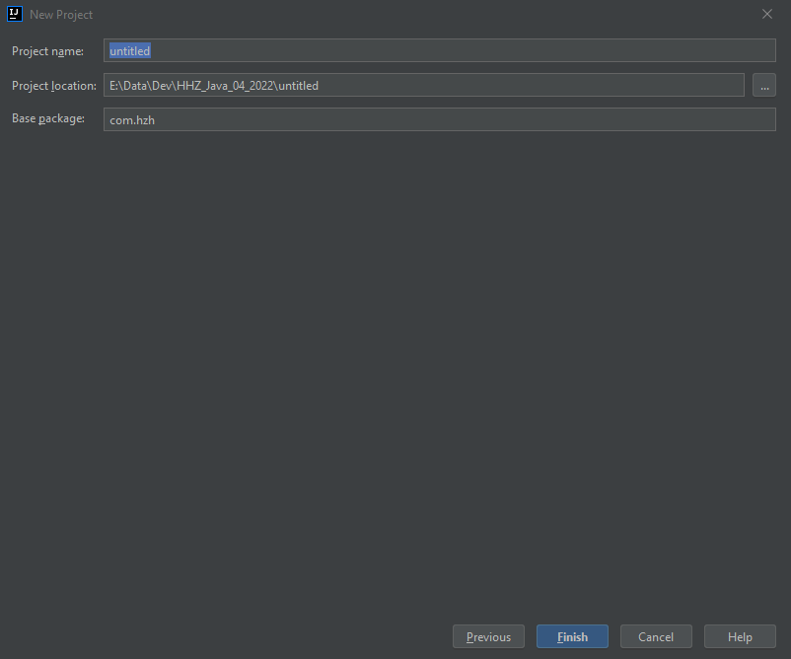
Creating a new project 4 of 5
Preparation
Give it a name
Local directory
Name space
Press Next

Slide 20
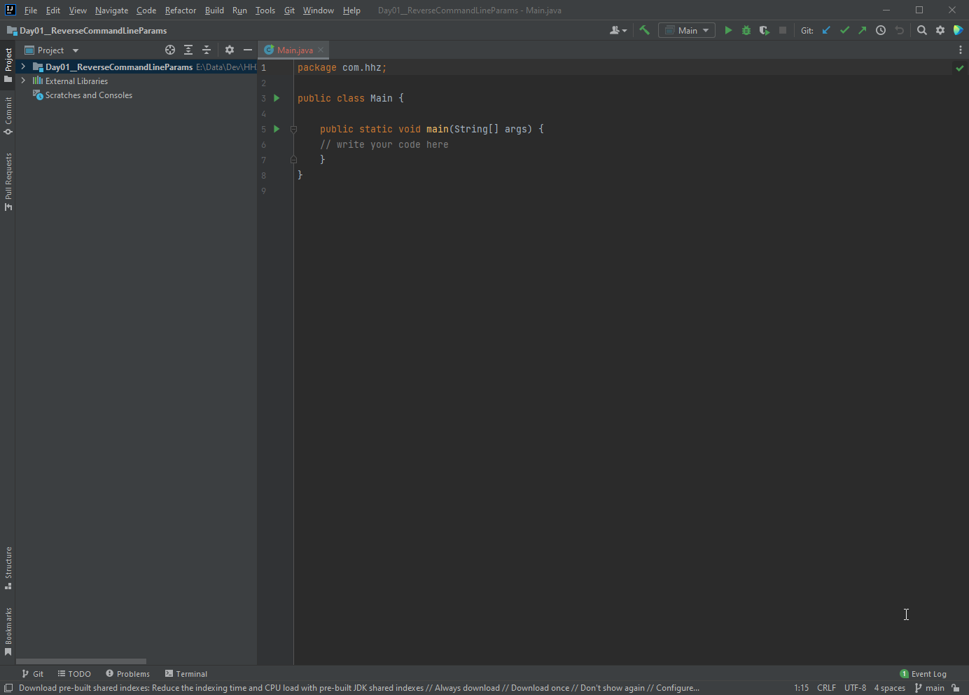
Creating a new project 5 of 5
Preparation
Resulting project

Slide 21
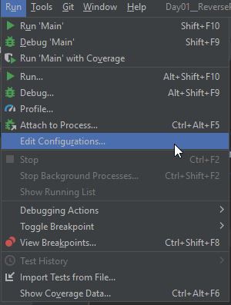
Run with Command Line Params 1 of 2
Preparation
Adjust the configuration

Slide 22
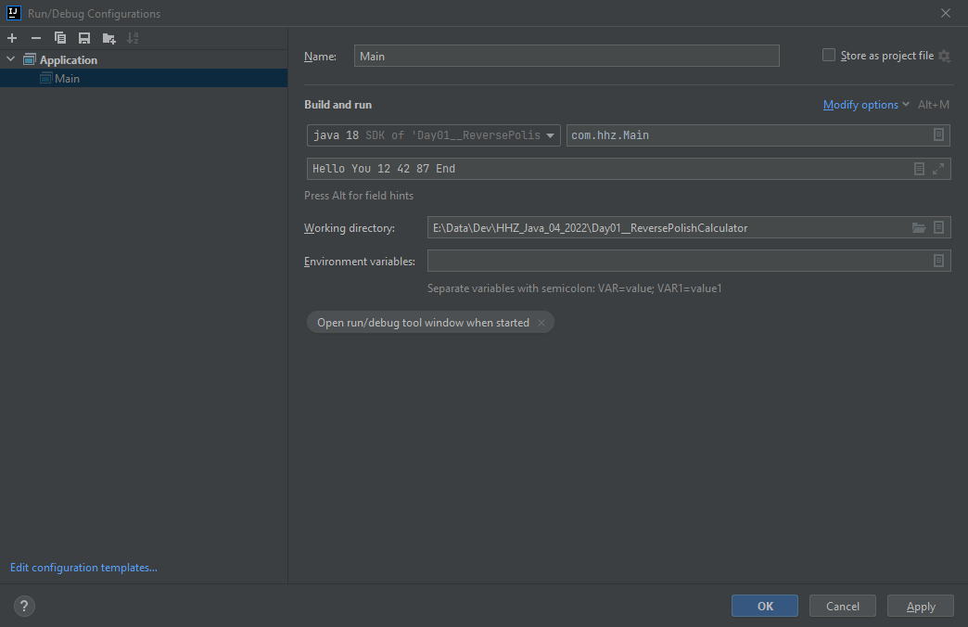
Run with Command Line Params 1 of 2
Preparation
Here go the command
Line params

Slide 23
Table of Content
Project used in the lecture
Day 1: Playing with Java / Deepen the knowledge
Day 2: User Interfaces
Day 3: Networking – From Socket to Message Bus
Day 4: Working with Databases ( SQL and No-SQL )
Day 5: Wrap-Up and Overflow

Slide 24
Command line parameters
Day 1
The main function takes the command line parameters in an String array
Each parameter is passed on as a String (String array after all)
In case of no command line parameters the String array is empty

Slide 25
Exercise 01
Day 1
Write a program, which prints out the command line parameters in reverse order

Slide 26
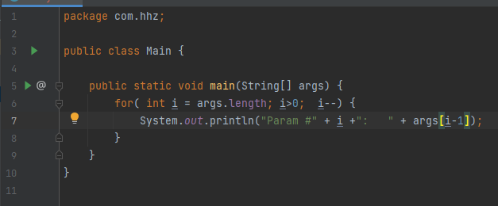
Exercise 01 - Solution
Day 1

Slide 27
Some methods of the String class
Day 1
(some) String class method | Functionality
String toLowerCase() | It returns a string in lowercase.
String toUpperCase() | It returns a string in uppercase.
String trim() | It removes beginning and ending spaces of this string.
int indexOf(String substring) | It returns the specified substring index.
String[] split(String regex) | It returns a split string matching regex.
boolean contains(CharSequence s) | It returns true or false after matching the sequence of char value.
int length() | It returns string length. Compare to Array.length !!
String substring(int beginIndex, int endIndex) | It returns substring for given begin index and end index.

Slide 28
Exercise 02 – Playing with String comparison
Day 1
Take the code on this slide
Run it
Explain the results

Slide 29
Exercise 03 – Playing with String concatination
Day 1
Take the code on this slide
Run it
Explain the results

Slide 30
Integer class – parsing of text
Day 1
int Integer.parseInt( String ) tries to convert the String into an integer value. Throws an exception if that not possible. Ex: Integer. parseInt(„411“) → 411 Integer. parseInt(„Axx“) → Throws exception

Slide 31
Try – catch - finally
Day 1
In order to control code, which might throw exceptions it is enclosed in a try-catch (-finally) construct: try { // Code, which might throw exeptions } catch( Exception ex ) { // Code to run if an exeption happened } finally { // Code, which runs wether an exeption was thrown }

Slide 32
Exercise 04
Day 1
Write a program, which prints out the command line parameters in reverse order.
Add 10 to each integer value in the list before printing it out.

Slide 33
Class Stack
Day 1
Growths ( aka Push operation) upwards
Shrinks (aka Pop operation) downards
There are only the push and pop operations for accessing the stack.
Push 5
5
4
3
Push 4
4
3
Push 3
3

Slide 34
Unit testing
Day 1
Small test of parts of code
Always test one thing and one thing only
Expected to run fast
YES, I know of projects where the code for testing exceeded the code under test.

Slide 35
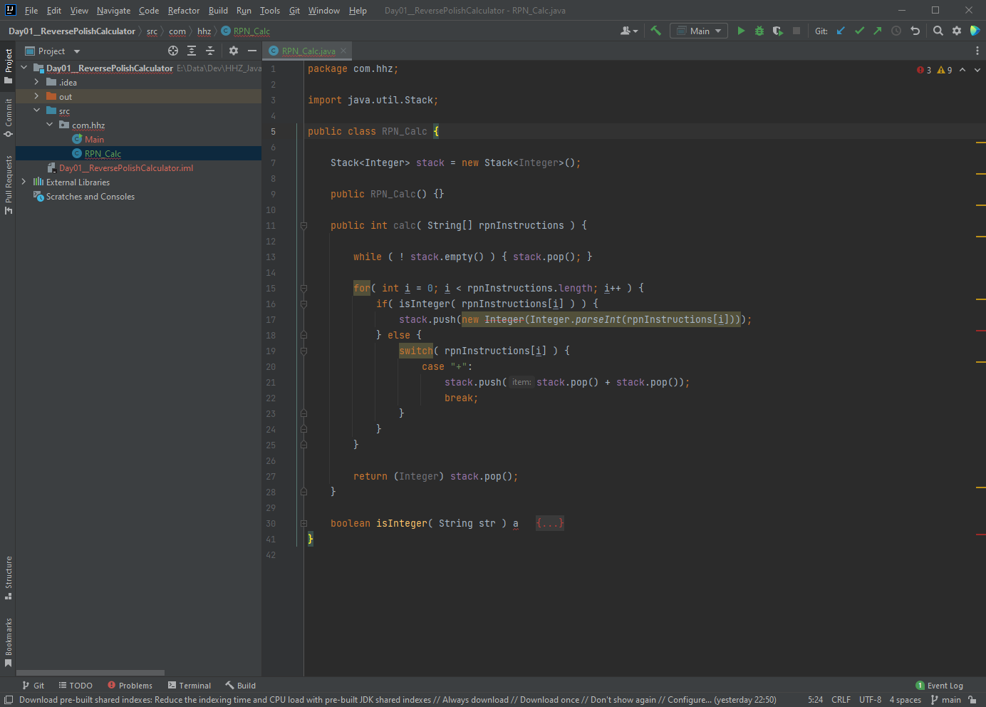
Unit testing
Day 1
In order to create Unit tests move the cursor over the class name and press the right mouse button → context menu

Slide 36
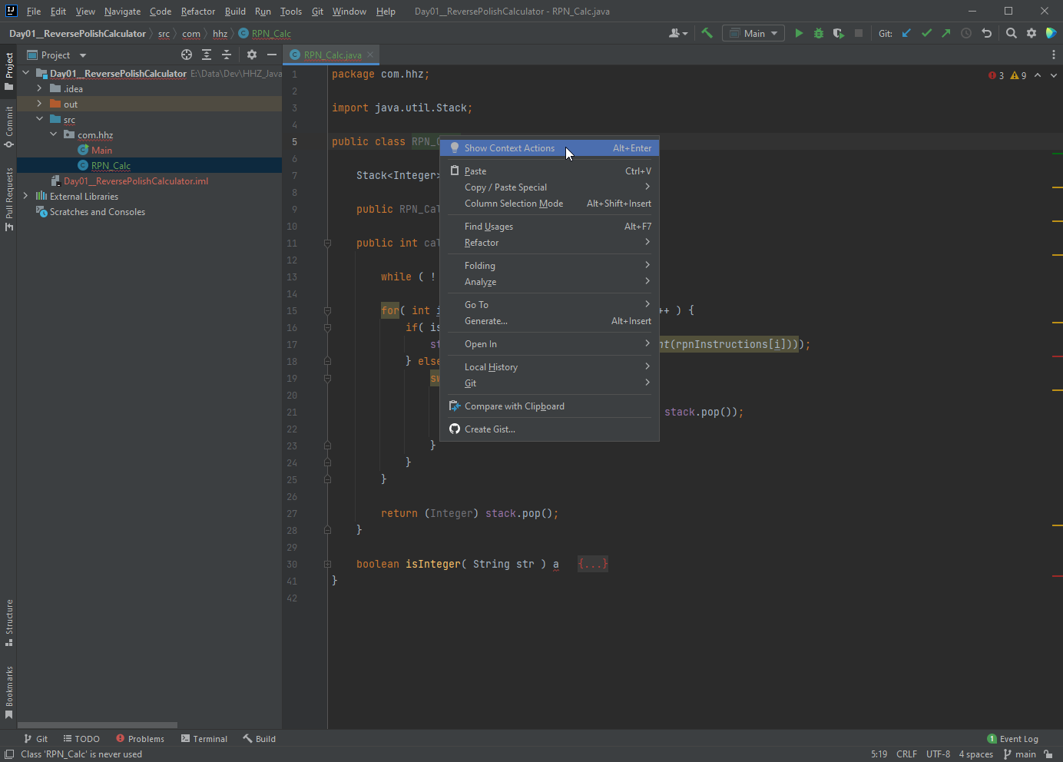
Unit testing
Day 1
Choose „Show Context Action“

Slide 37
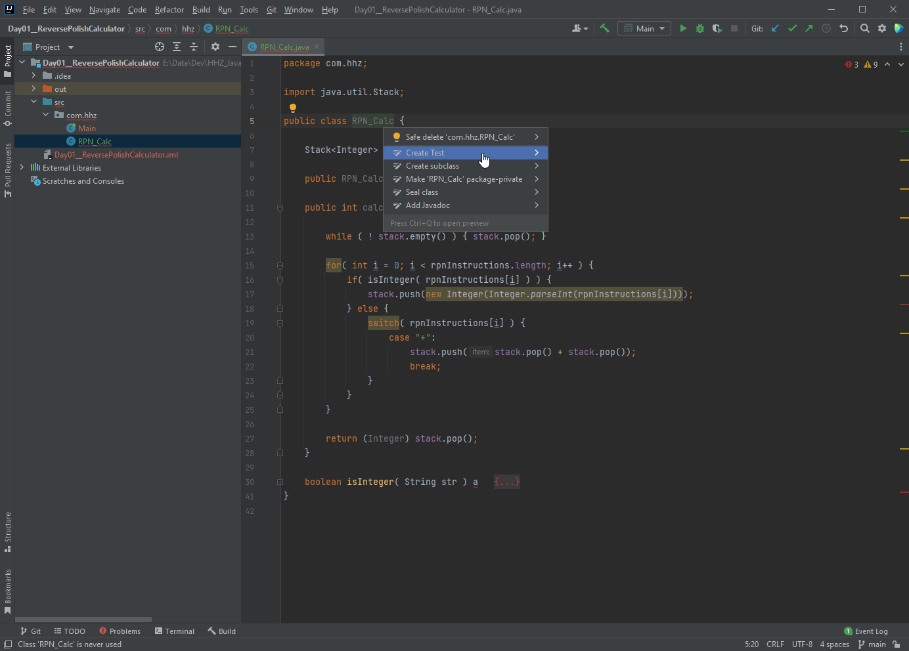
Unit testing
Day 1
Choose „Create Test“

Slide 38
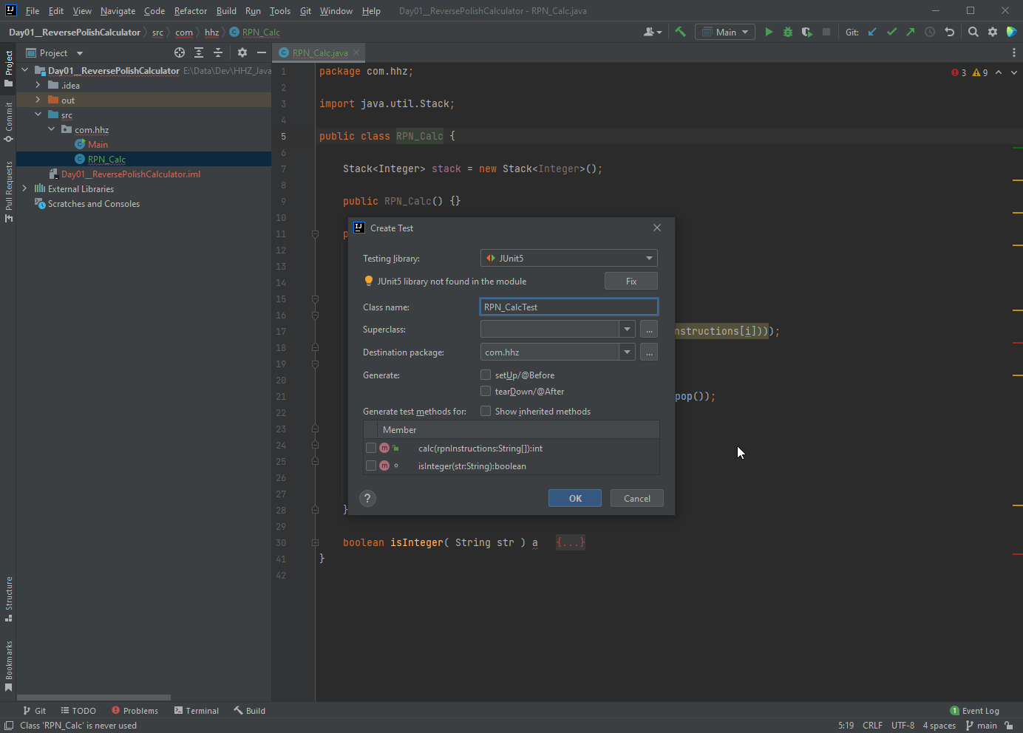
Unit testing
Day 1
When done for the first time the Junit jar file needs to be added to the project. Press „Fix“

Slide 39
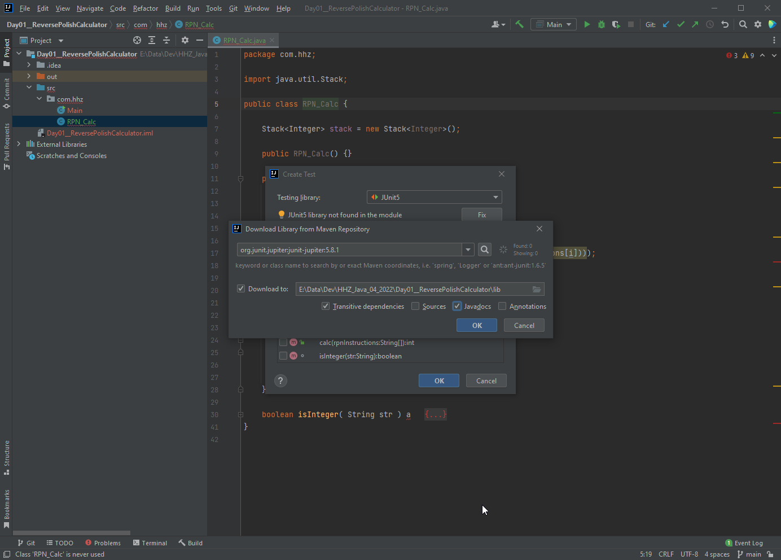
Unit testing
Day 1
Add the Junit jar file Download Javadoc as well.

Slide 40
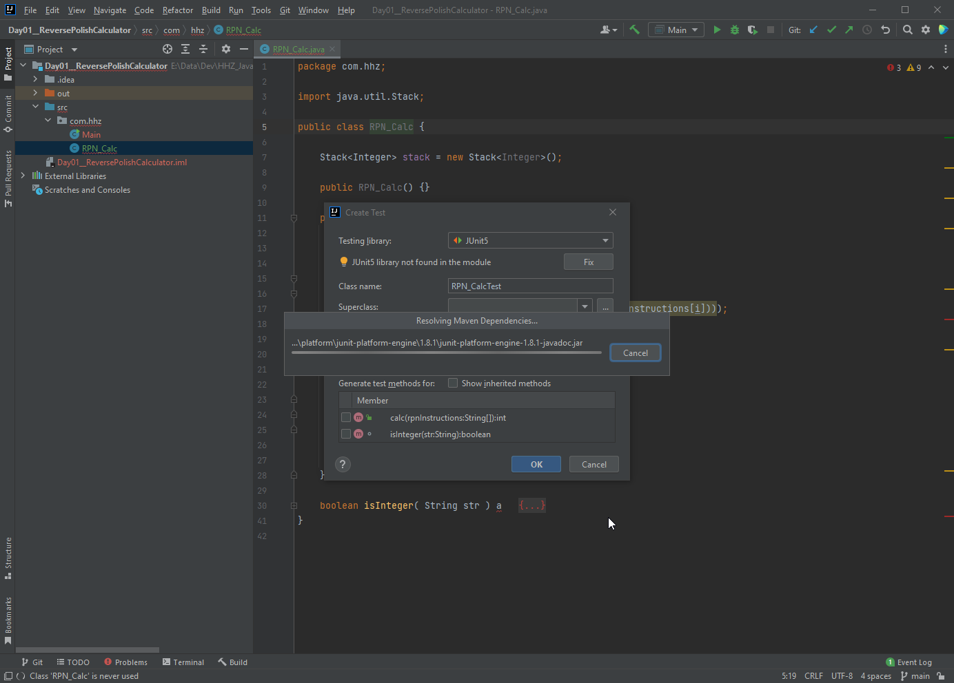
Unit testing
Day 1
IntelliJ downloads the required files

Slide 41
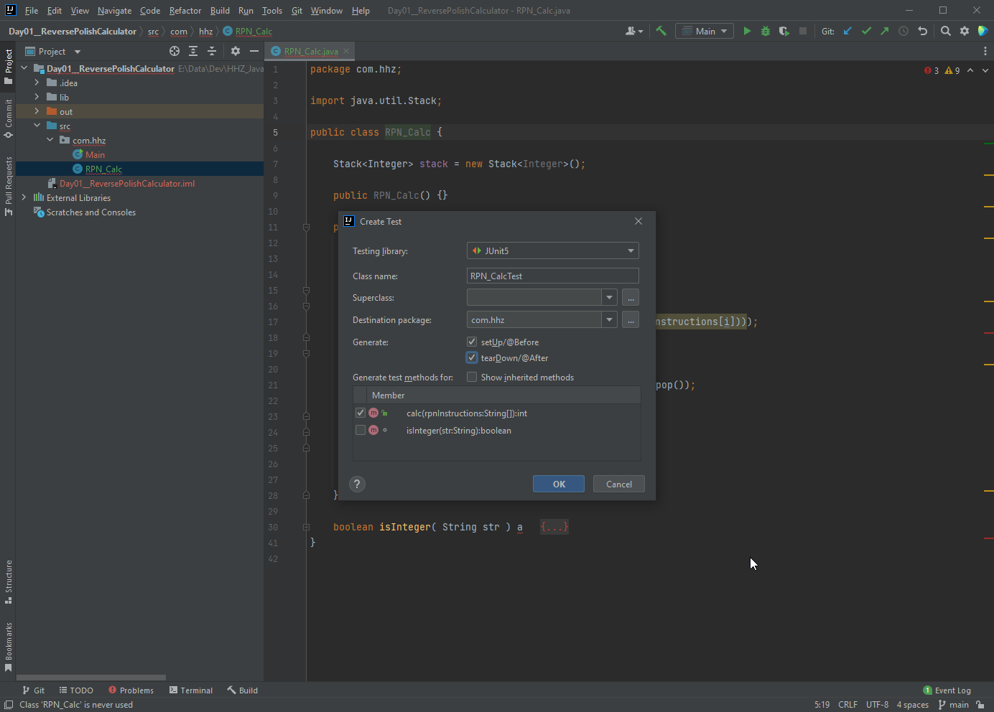
Unit testing
Day 1
Create the Junit test skeleton for the calc method Create the Setup & TearDown methods

Slide 42
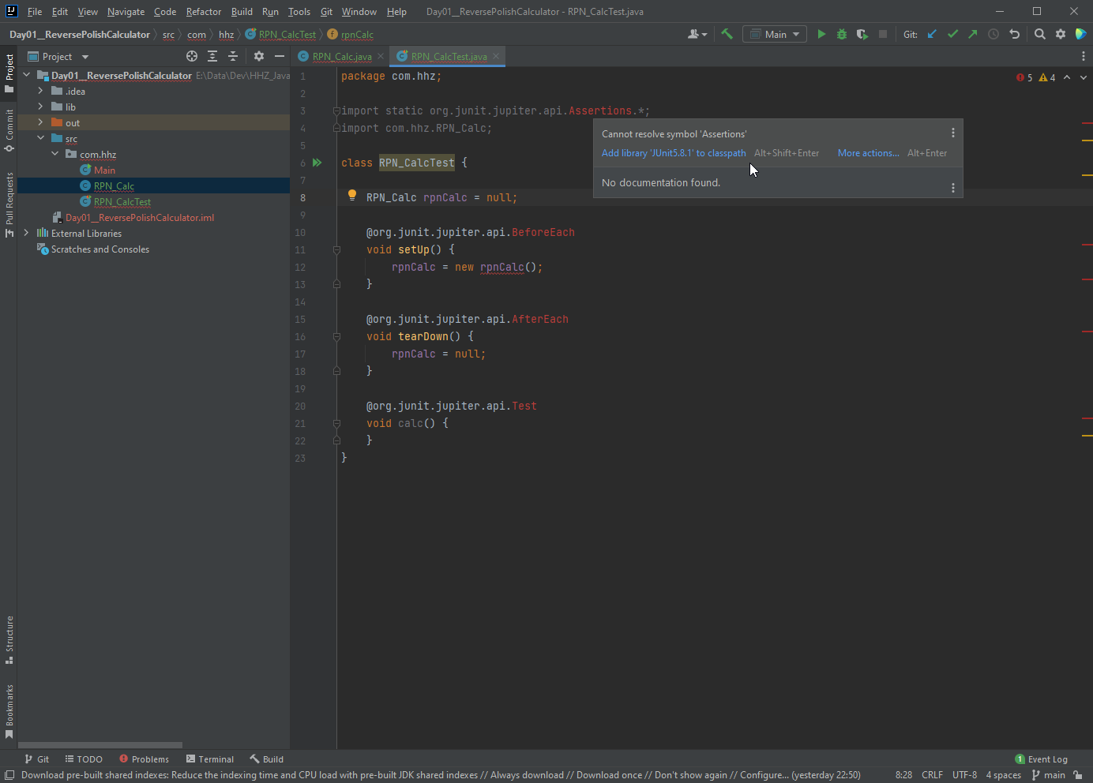
Unit testing
Day 1
Need to add the Junit library to the classpath.

Slide 43
Exercise
Day 1
Create a class Calc
With one method int add( int a, int b), which returns the sum of a and b
Create multiple tests for this method

Slide 44
UPN
Day 1
Add 10 and 20: 10 20 +
3*(4+2) 4 2 + 3 *

Slide 45
Exercise 05
Day 1
Create a class RPN, which has this method:
int calc( String [ ] rpnInstructions );
It takes a string array as input, which contains the operands and the operators in correct order for the calculation
It returns the result of the calculation
Only integer values are used in the calculation
Add Unit testing for verification of the correctness of the class

Slide 46
Exercise Converter
Day 1
Create a Converter class, which is able to take in a text string in Markdown text and convert it into Latex
For starters we need to translate the Headings first
The first character in a line is a ‚#‘,maybe followed by more of them
The first non-‘#‘-character to the end of the line is the Header text
All other text (Markdown tags or not) is simply copied to the Latex file.
Create a Main-method, which takes the Markdown-Filename from the command line.
The Latex file has the same file name as the Markdown file, just ending in ‚.latex‘
Feel free to convert other Makrdown tags as well

Slide 47
Exercise Converter - Hints
Day 1
ArrayList<String>
String class:
charAt
indexOf
substring
trim

Slide 48
SWING - User Interface
Day 2

Slide 49
A simpe Swing application
Day 2
JFrame is the class providing a window for an application.
Inside of the window there will be components for user information and interaction

Slide 50
Excercise 1
Day 2
Build an application, which shows an empty window
Play with it. Is there any difference to other windows from other applications?

Slide 51
Hints
Day 2
JFrame.setSize(int, int) allows to set the dimensions of the window.
In order to end the application when the window gets closed one needs to add an event listener: window.addWindowListener(new WindowAdapter() {
public void windowClosing(WindowEvent windowEvent){
System.exit(0);
}
});

Slide 52
Components
Day 2
There are many different components available.
We will start out with JButton and JLable

Slide 53
Excercise 2
Day 2
Add a button to the window
Anything the matter?
Try adding a second button
What happens then?

Slide 54
Layout manager
Day 2
In order to achieve control over the positioning of the different components in a window Swing offers different Layout managers.
Layout managers can be nested.
The different Layout manages are shown here.

Slide 55
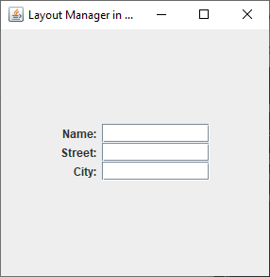
Excercise 3
Day 2
Use the GridbagLayout Manager to construct the following screen with JLables and JTextFields(width 10)

Slide 56
Working with events
Day 2
In order to react to the push of a button it (the button) needs to listen to such an event. button.addActionListener(new ActionListener() {
@Override
public void actionPerformed(ActionEvent e) {
System.out.println( ((JButton)e.getSource()).getText() );
}
});
See Different ways to implement a listener

Slide 57
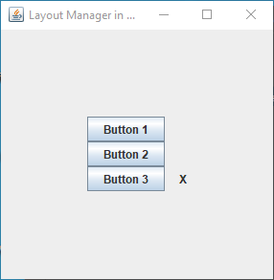
Excercise 4
Day 2
Create a little application, which shows an X next to the button, which was clicked last: Example:

Slide 58
Picking a file name
Day 2
JFileChooser brings up a dialog box for choosing a file name
JFileChooser jfc = new JFileChooser(new File(System.getProperty("user.home")));
int result = jfc.showOpenDialog(parent_window);
if (result == JFileChooser.APPROVE_OPTION) {
// jfc.getSelectedFile() gets the file name
// Work with the file name here
}

Slide 59
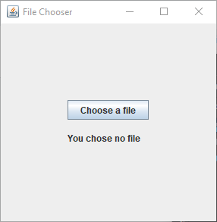
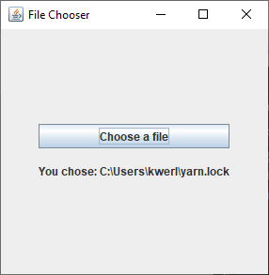
Excercise 5
Day 2
Create an application, which shows the file name chosen from a JFileChooser component: Example:

Slide 60
Long running Actions
While an Action is running the UI is blocked for input or updates
The reason for this is, that the Action code is running int he same thread as the UI code
In order to prevent this one needs to work with calss SwingWorker, which runs the Action code in another thread
While the action is running in another thread one needs to de-activate or block access to ohter UI elements (as needed)

Slide 61
Excercise 6
Day 2
Write a UI, which asks the Markdown file name from the user
Then it calls the converter code from Day 1
The output is saved in a „.latex“ file
If time permits do the latex to pfd translation
Show the pdf in a viewer. (This part we have not talked about an you will have work out how an external process can be called (and controlled) from Java) →

Slide 62
Excercise 6
Day 2
Run an external program from within your Java code: Runtime run = Runtime.getRuntime(); Process proc = run.exec(<<Path and Filename>>);
Through the instance of the process class one can get access to stdin, stdout, and stderr of the process.
The commands, the path to them, the expected input and output and so on are all platform dependent.

Slide 63
Preparation for Day 3
Day 2
Setup WSL
On a command line enter: wsl --install
This will setup UBUNTU as an additional OS on your machine
Reboot might be required
You will be asked for a user name and a password (these have nothing to do with your windows user or password)
Install windows terminal as described here: Windows Terminal Install from MS Store
For the not so faint at heart folks the WSL install is described here.
Ignore the rest of the installation instructions

Slide 64
Preparation for Day 3
Day 2
Install Docker Desktop
Install Docker Desktop from here.
Verify that everything went successful (Step 6) : Test that your installation works correctly by running a simple built-in Docker image using: docker run hello-world It should not matter if you run the command from a windows command prompt or from the ubuntu command prompt.

Slide 65
Preparation for Day 3
Day 2
Stop the installed programs
Exit the Docker Desktop program by right-clicking on the icon in the taks bar and choose „Exit“
Stop Ubuntu by entering wsl --shutdown at the windows command prompt

Slide 66
Networking
Day 3
We will look into 3 technologies: -1- Sockets (the basic, underlying technology) -2- Restful Web Services (what the WEB is based on) -3- Message Bus (Easiest way to have Applications co-operate)

Slide 67
Networking - Sockets
Day 3
Sockets are described as Communication End Points
They are a logical construct, there is no physical socket representing them
Usually an OS offers a little over 65 thousands sockets (Why?)
The first 1024 (why?) sockets are so called well-known sockets. They support such services as ftp, telnet, ssh, mail, and so on.

Slide 68
Networking - Sockets
Day 3
For having two (or more) computers communicate via sockets one needs at least two different applications: -1- A server, which waits for and manages connections -2- A Client, which can connect to the server
Most servers can handle more than one client connection at once.
Of course, once can run both Application on a single machine.

Slide 69
Networking - Sockets
Day 3
Here is the bare server code (single, one time connection only):
private ServerSocket serverSocket;
private Socket connectionSocket;
private PrintWriter out;
private BufferedReader in;
public void start(int port) throws IOException {
serverSocket = new ServerSocket(port);
connectionSocket = serverSocket.accept();
out = new PrintWriter(connectionSocket.getOutputStream(), true);
in = new BufferedReader(new InputStreamReader(connectionSocket.getInputStream()));
String str = in.readLine();
out.println("Echo: " + str);
}

Slide 70
Networking - Sockets
Day 3
Here is the bare client code (single, one time connection only):
private Socket clientSocket;
private PrintWriter out;
private BufferedReader in;
public void startConnection(String ip, int port) throws IOException {
clientSocket = new Socket(ip, port);
out = new PrintWriter(clientSocket.getOutputStream(), true);
in = new BufferedReader(new InputStreamReader(clientSocket.getInputStream()));
}
public String sendMessage(String msg) throws IOException {
out.println(msg);
String resp = in.readLine();
return resp;
}

Slide 71
Networking – Sockets – Exercise 01
Day 3
Create two applications, one server and one client (a) Run it locally on your machine (b) Find another group and let your client talk to their server. (c) Add logic to the server to allow for more than one message to be sent and echoed. Modify the client code accordingly.

